Slide 1
MLSA Full Stack Web Development Internship Presentaion
Name: Ravi yadav
University Roll No. 2200290100127
CSE 5_B 2022-26 batch

Slide 2


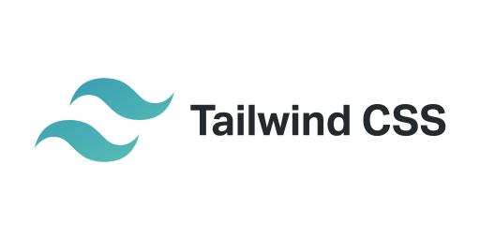
Tech Stack used
React is the library for web and native user interfaces. Build user interfaces out of individual pieces called components written in JavaScript.
React Router is a JavaScript framework that lets us handle client and server-side routing in React applications
Tailwind CSS is a utility-first CSS framework for rapidly building modern websites without ever leaving your HTML.

Slide 3
BLOG app Features
Create
Users can add new blog posts by filling out a form with fields for the post title and content.
The new post is saved and immediately displayed in the list of blog posts.
Read
All blog posts are displayed on the home page in a concise format, showing titles and brief content previews.
Users can click on a blog post to view the full content on a separate page.
Update
Users can edit existing blog posts by clicking the "Edit" button on each post.
The edit functionality uses the same form as the create function, allowing users to update the post’s title or content.
Delete
Users can delete any blog post by clicking the "Delete" button next to the post.
Deleting a post removes it from both the display list and local storage.

